Slide 1
Oxycontin and Pain Medication

Slide 2
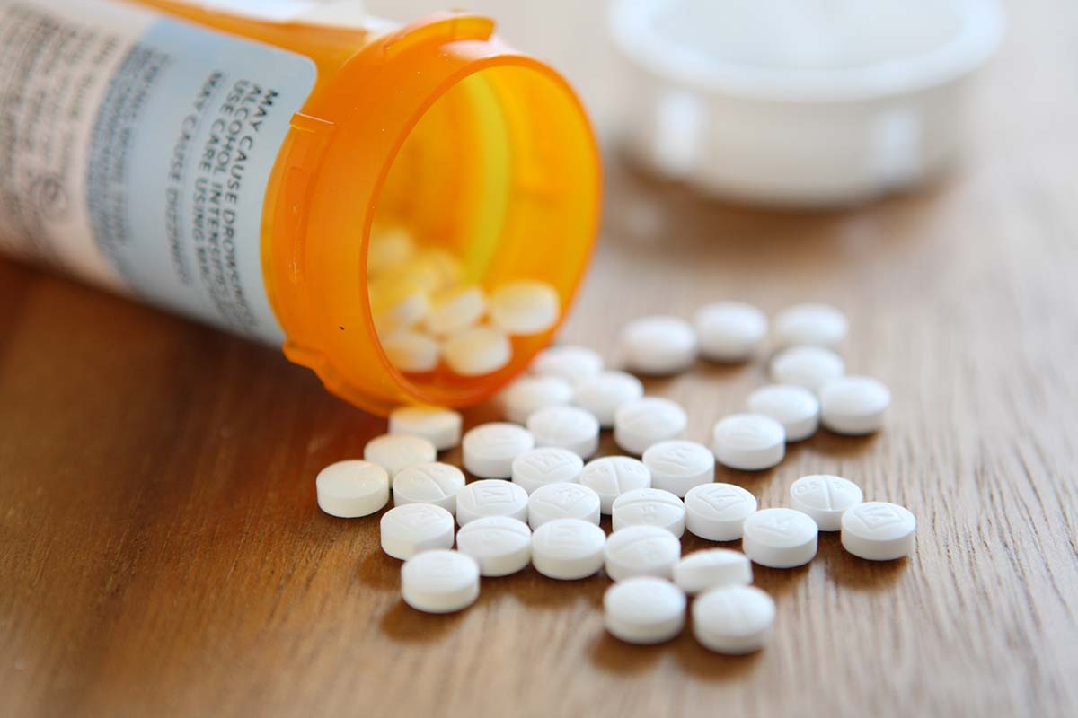
Hypothesis
There is a significant correlation between pain-relief medication use and Oxycontin use across age groups.

Slide 3
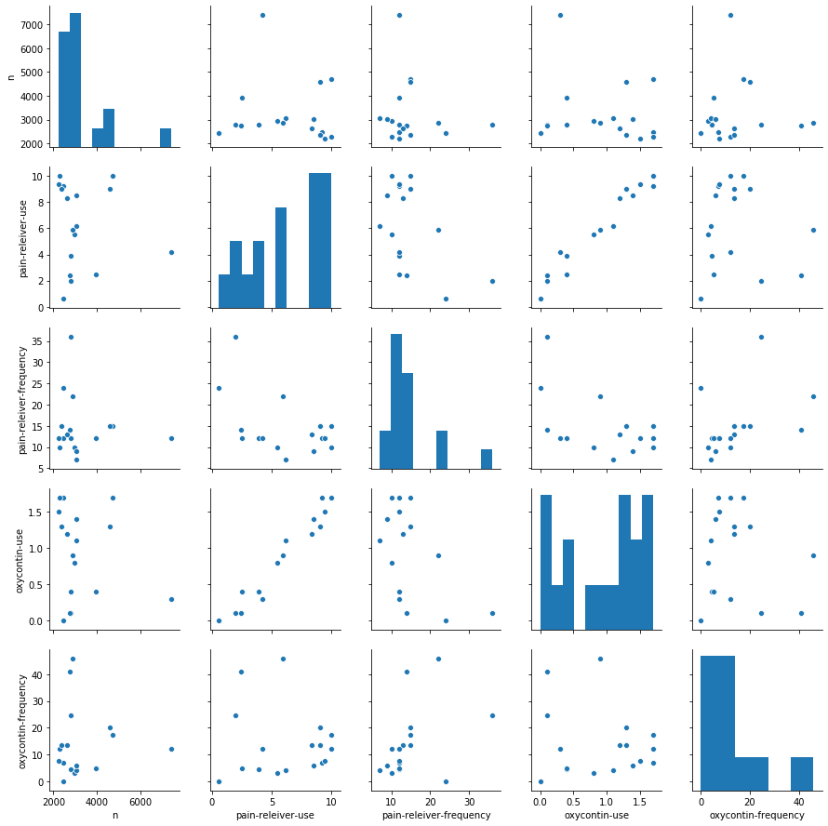
Overview of the data
There is a clear visual positive correlation between Pain-relief medication and Oxycontin use.
There seems a slight negative correlation between pain-relief drug use and frequency
Samples per age group cluster around 2000 to 3000

Slide 4
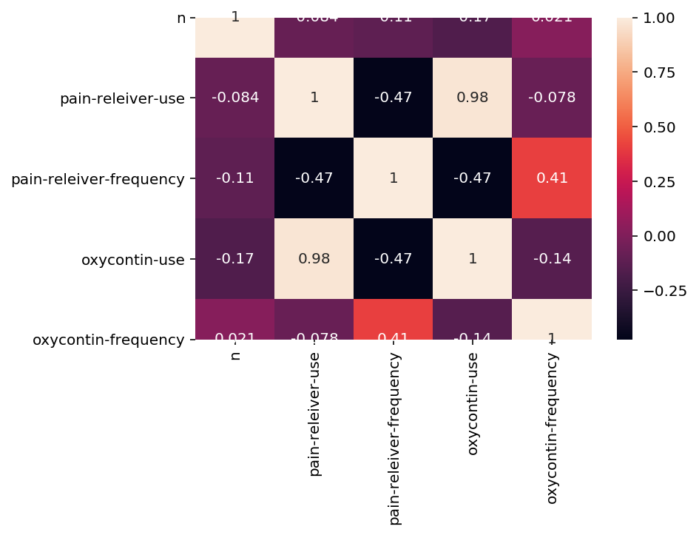
Detailed Correlation
As the previous overview indicated there is a strong positive correlation of 0.98 between the use of each drug.
Also note a minor negative correlation between pain-relief med use and frequency.

Slide 5
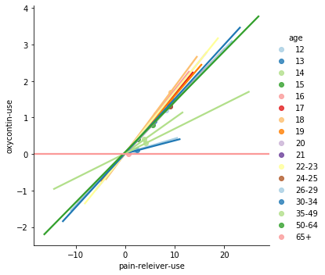
Correlation between drugs within each age group
Each line represents gradient between drugs use in each age group.
Similar gradients suggest correlation is consistent within age groups.

Slide 6
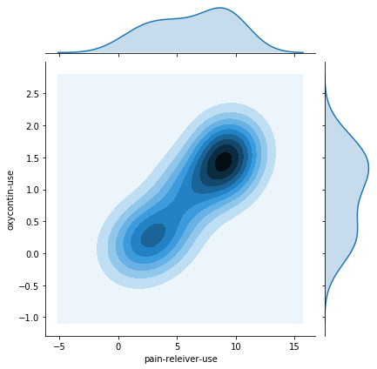
Drug use rate
There seems to be more of each age group clustered to the higher end of drug usage.
This suggests that a higher use of either drug will correlate to a higher use of the other.

Slide 7
Q & A

